Slide 1
Welcome & Module Induction
What we learned previously: In Module 6, we learned how to "remote control" other applications and systems using the subprocess module and handle system exit codes to build robust automation pipelines.
What we are learning today: We are diving into the "Power Tools" of the Python Standard Library. We will master the collections module for faster data structures, itertools for memory-efficient looping, and Regular Expressions (re) for advanced text pattern searching.
Why this will be helpful: In AI research and high-speed backend engineering, standard lists and basic loops are often too slow or consume too much RAM. When you are processing 1,000,000 log entries or generating every possible combination of hyperparameters for a YOLO model, these advanced tools will keep your system from crashing and make your code run 10x faster.

Slide 2
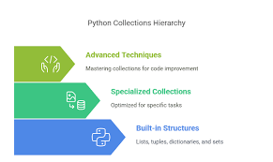
The collections Module (Beyond Standard Lists)
Namedtuple: Replaces simple tuples with readable objects. Instead of pixel[0], you use pixel.red.
Deque (Double-Ended Queue): A list optimized for fast adding/removing from both ends. Perfect for "sliding window" algorithms in video processing.
Counter: A specialized dictionary that counts occurrences instantly.

Slide 3
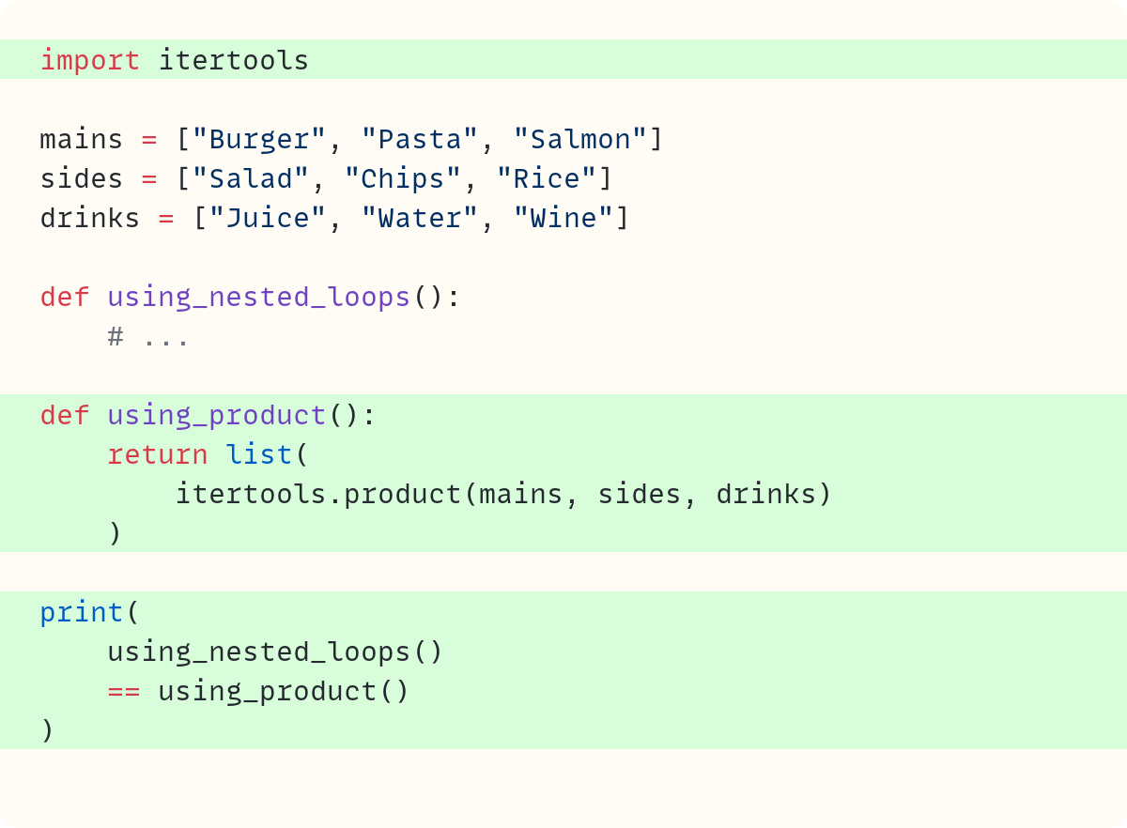
itertools for Efficiency
The RAM Problem: Creating a list of 1,000,000 combinations of data will crash most computers.
The Iterator Solution: itertools creates "iterators"—it calculates the next item only when you need it, rather than storing the whole list in memory.
Key Tools: combinations and permutations. These are essential for "Grid Searches" when tuning AI models to find the best settings.

Slide 4
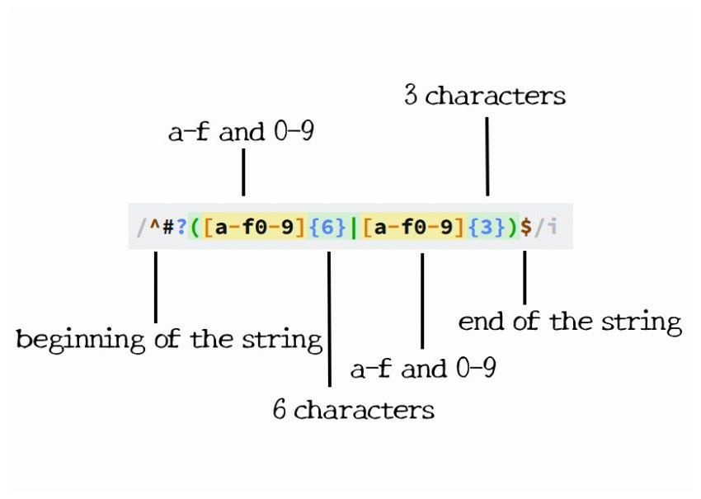
Regular Expressions (re)
The Pattern Search: If you need to find every email address in a 5,000-page medical document, a standard if "word" in text search is impossible.
The Logic: Regex uses a specialized language (e.g., \d{3}-\d{3}-\d{4} for phone numbers) to scan text for patterns rather than exact words.

